Slide 1
Chapter 9

Slide 2
Objectives

Slide 3
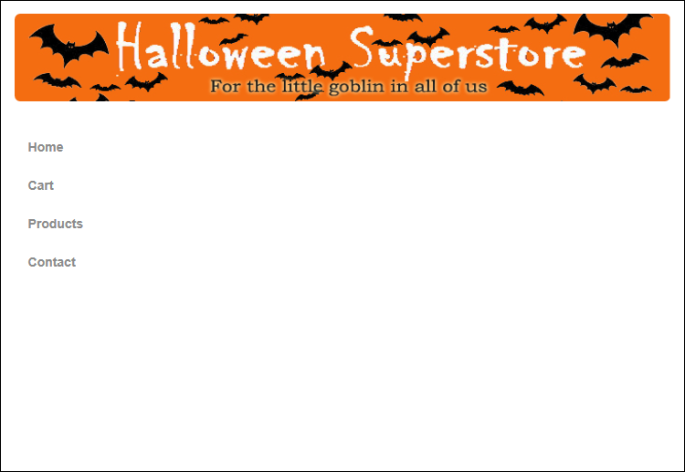
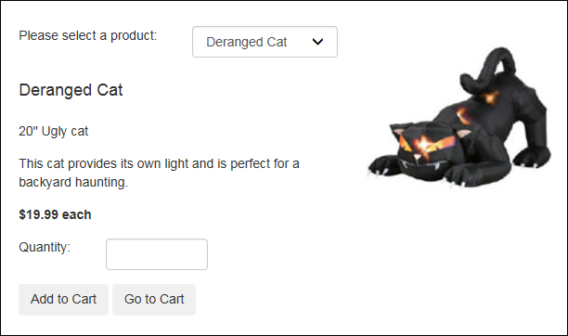
The Shopping Cart application with a master page

Slide 4
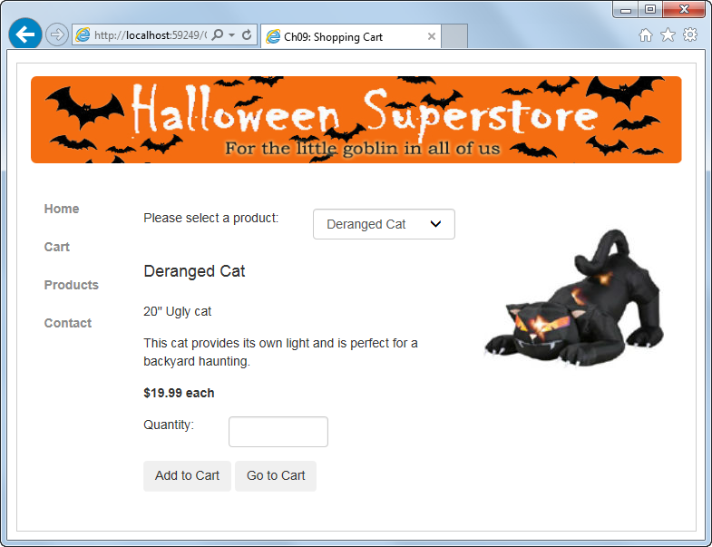
The rendered master and content page

Slide 5
The starting code for a master page

Slide 6
The form element of the master page after content is added

Slide 7
The form element of the master page after content is added (cont.)

Slide 8
How to add a master page to a project

Slide 9
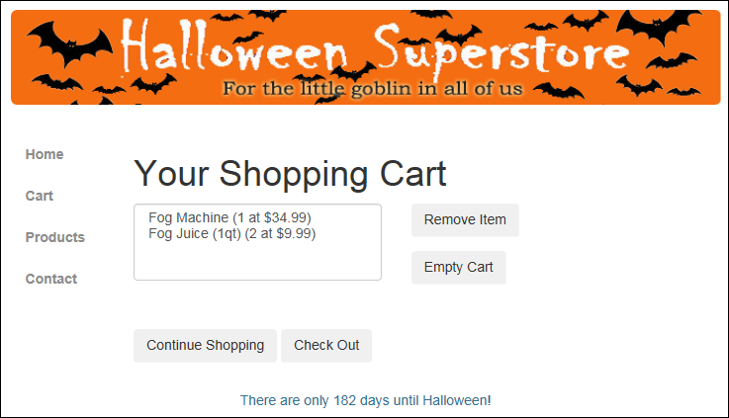
A page with the ClientIDMode attribute set to Predictable

Slide 10
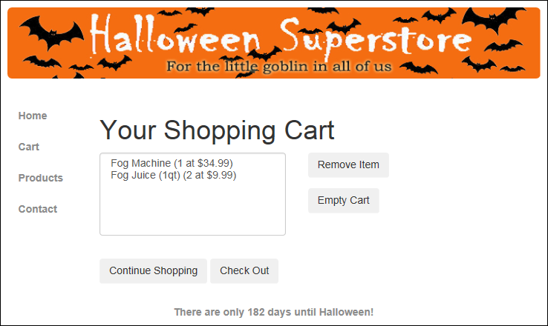
A page with the ClientIDMode attribute set to Static

Slide 11
Values of the ClientIDMode attribute

Slide 12
The select elements generated for a list box

Slide 13
The starting code for a new content page

Slide 14
Two ways to add a content page to a project

Slide 15
How to convert a regular ASP.NET page to a content page

Slide 16
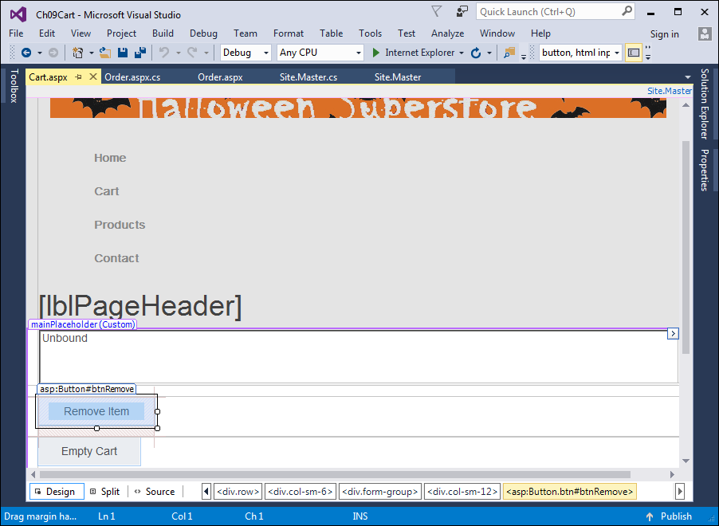
The beginning of the Cart page in Design view

Slide 17
The aspx code for the controls in the Content control

Slide 18
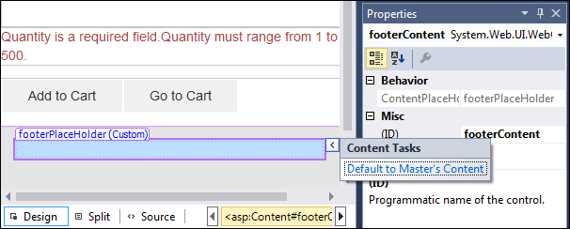
The smart tag menu for a placeholder on a content page

Slide 19
To set the default title in a master page, enter the content for the title element

Slide 20
How to set default content in a master page

Slide 21
How to display a placeholder’s default content in a content page

Slide 22
How to expose a public property in a master page

Slide 23
Attributes of the MasterType directive

Slide 24
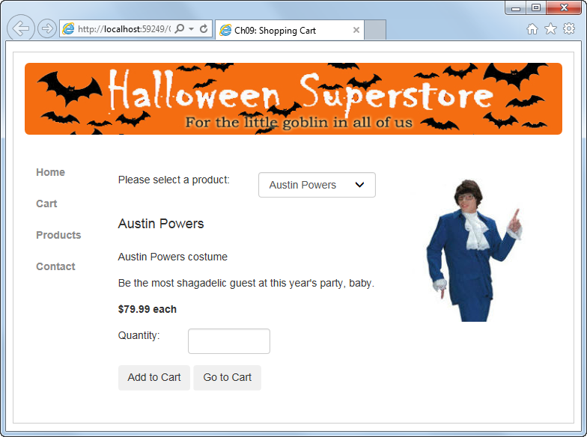
The Order page

Slide 25
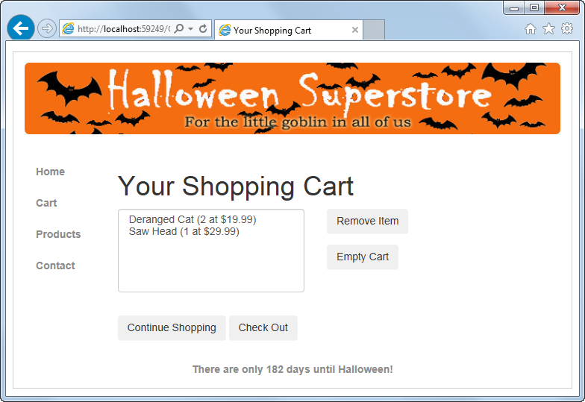
The Cart page

Slide 26
The aspx code for the master page

Slide 27
The aspx code for the master page (cont.)

Slide 28
The aspx code for the master page (cont.)

Slide 29
The code-behind file for the master page

Slide 30
The code-behind file for the master page (cont.)

Slide 31
The code-behind file for the master page (cont.)

Slide 32
The aspx code for the Order content page

Slide 33
The aspx code for the Order content page (cont.)

Slide 34
The aspx code for the Cart content page

Slide 35
The aspx code for the Cart content page (cont.)

Slide 36
The load event for the Cart content page

Slide 37
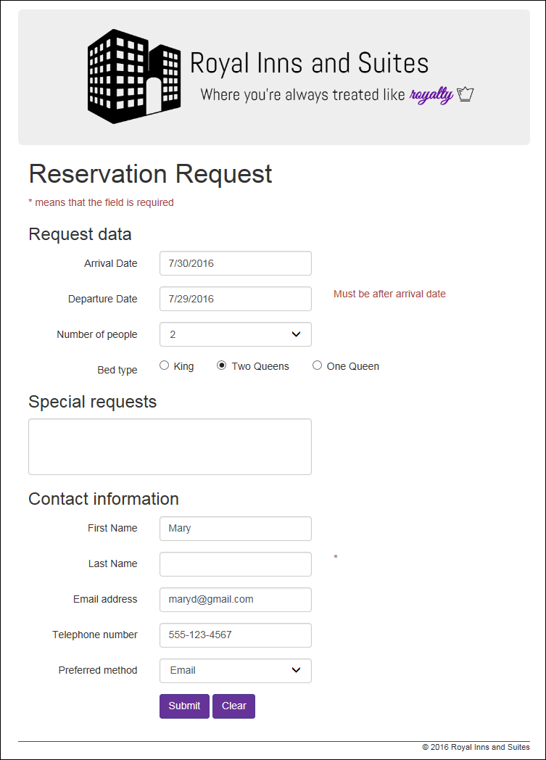
Extra 9-1 Create a master page for the Reservation application

